Slide 1
Lesson U01.05 - The place-image Function
Aim: How do we compose functions?

Slide 2
notes 1/4 - place-image example
(place-image
(circle 50 “solid” “red”)
25 100
(square 100 “solid” “blue”))

Slide 3
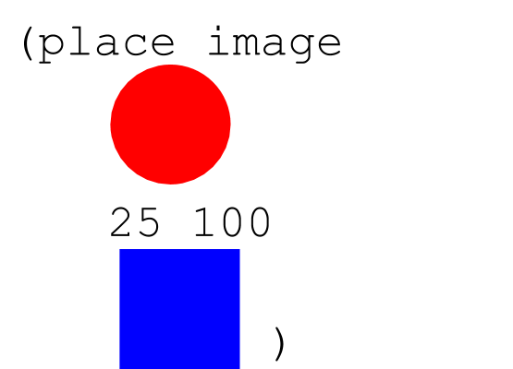
notes 2/4
is the same as...

Slide 4
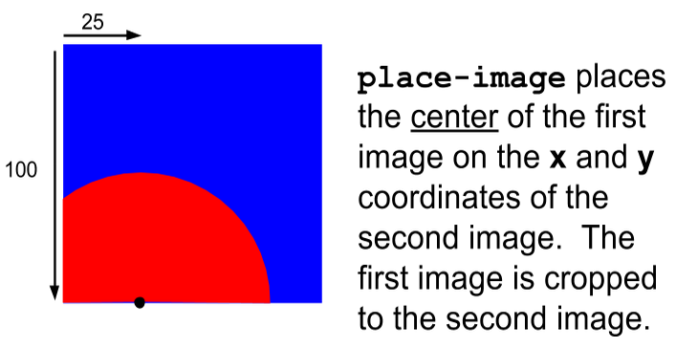
notes 3/4
which evaluates to...

Slide 5
notes 4/4 - composition of expressions
to consume the result of one expression as the argument of another

Slide 6
Example 1
(place-image
(circle 50 “solid” “red”)
25 100
(square 100 “solid” “blue”))

Slide 7
place-image circle of evaluation
place-image

Slide 8
place-image circle of evaluation
place-image
circle
50 “solid” “red”

Slide 9
place-image circle of evaluation
place-image
circle
50 “solid” “red”
image

Slide 10
place-image circle of evaluation
place-image
circle
50 “solid” “red”
25
100

Slide 11
place-image circle of evaluation
place-image
circle
square
50 “solid” “red”
25
100
100 “solid” “blue”

Slide 12
place-image circle of evaluation
place-image
circle
square
50 “solid” “red”
25
100
100 “solid” “blue”
number
number
image
image

Slide 13
place-image circle of evaluation
place-image
image
circle
square
50 “solid” “red”
25
100
100 “solid” “blue”

Slide 14
Think deeper
If the range of a place-image function is an image, could one place image expression be the argument of another place-image expression?

Slide 15
origin (0, 0) - top left corner
which evaluates to...

Slide 16
place image takes 4 arguments
(place-image
(circle 50 “solid” “red”)
25 100
(square 100 “solid” “blue”))
Argument 1
Arg 2
Arg 3
Argument 4

Slide 17
What is the data type of the 1st argument?
(place-image
(circle 50 “solid” “red”)
25 100
(square 100 “solid” “blue”))
Argument 1
Arg 2
Arg 3
Argument 4

Slide 18
What is the data type of the 1st argument?
(place-image
(circle 50 “solid” “red”)
25 100
(square 100 “solid” “blue”))
image
Arg 2
Arg 3
Argument 4

Slide 19
what other expressions could be Argument 1?
(place-image
(place-image
IMAGE1 x y IMAGE2)
25 100
(square 100 “solid” “blue”))
Argument 1
Arg 2
Arg 3
Argument 4

Slide 20
what other expressions could be Argument 1?
(place-image
(place-image
IMAGE1 x y IMAGE2)
25 100
(square 100 “solid” “blue”))
Arg 2
Arg 3
Argument 4

Slide 21
What is the data type of the 3rd argument?
(place-image
(circle 50 “solid” “red”)
25 100
(square 100 “solid” “blue”))
Argument 1
Arg 2
Arg 3
Argument 4

Slide 22
What is the data type of the 3rd argument?
(place-image
(circle 50 “solid” “red”)
25 100
(square 100 “solid” “blue”))
Argument 1
Arg 2
number
Argument 4

Slide 23
what other expressions could be passed as the third argument?
(place-image
(circle 50 “solid” “red”)
25 100
(square 100 “solid” “blue”))
Argument 1
Arg 2
Arg 3
Argument 4

Slide 24
what is the data type of the 3rd argument?
(place-image
(circle 50 “solid” “red”)
25 (* (+ 6 4) 100)
(square 100 “solid” “blue”))
Argument 1
Arg 2
Argument 4

Slide 25
three new functions
scale/xy
text
ellipse

Slide 26
Assignment
Create a plan for an image.
Code your image by following your plan.

